Slide 1
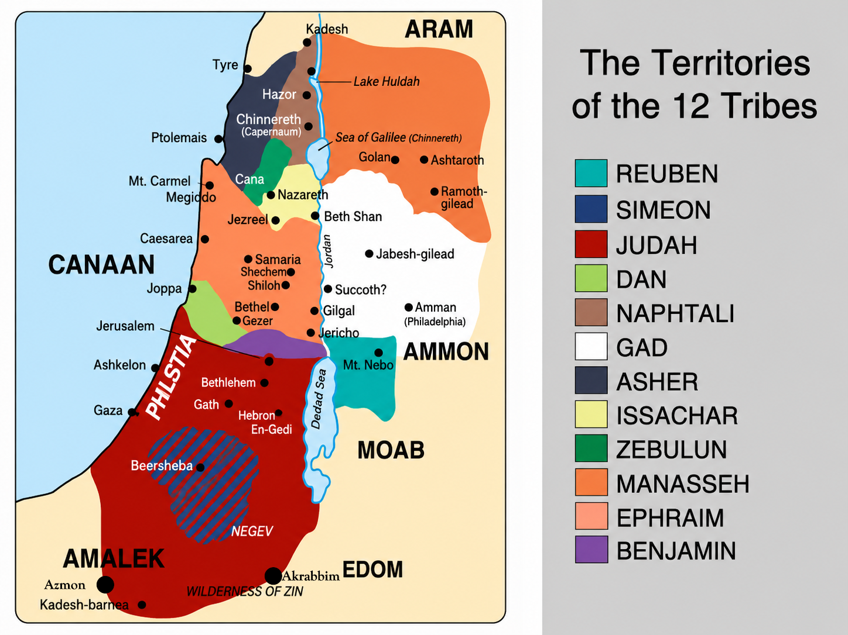
JOSHUA 15
FAITH REWARDED

Slide 2
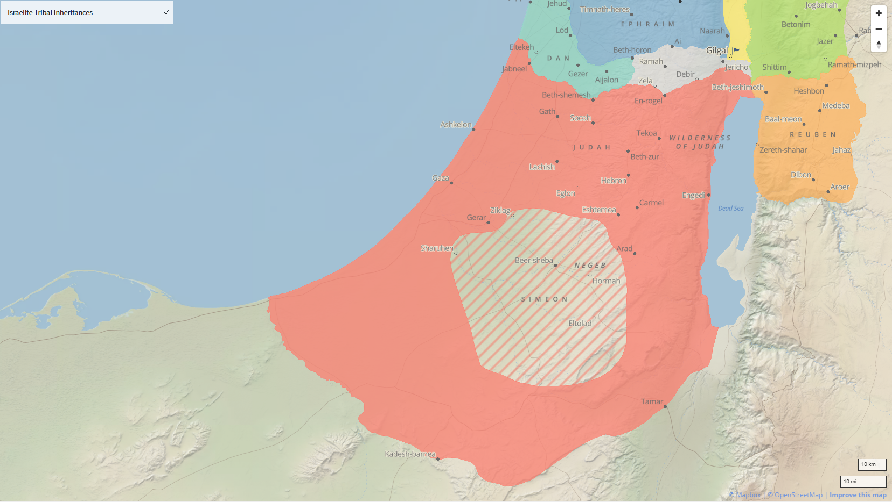
B
O
R
D
E
R
S
O
U
T
H
Mediterranean Sea
River of Egypt
Azmon
Akrabbim
Wilderness of Zin in the South

Slide 3
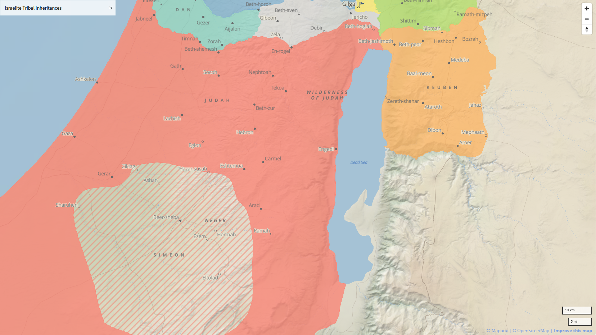
B
O
R
D
E
R
E
A
S
T

Slide 4
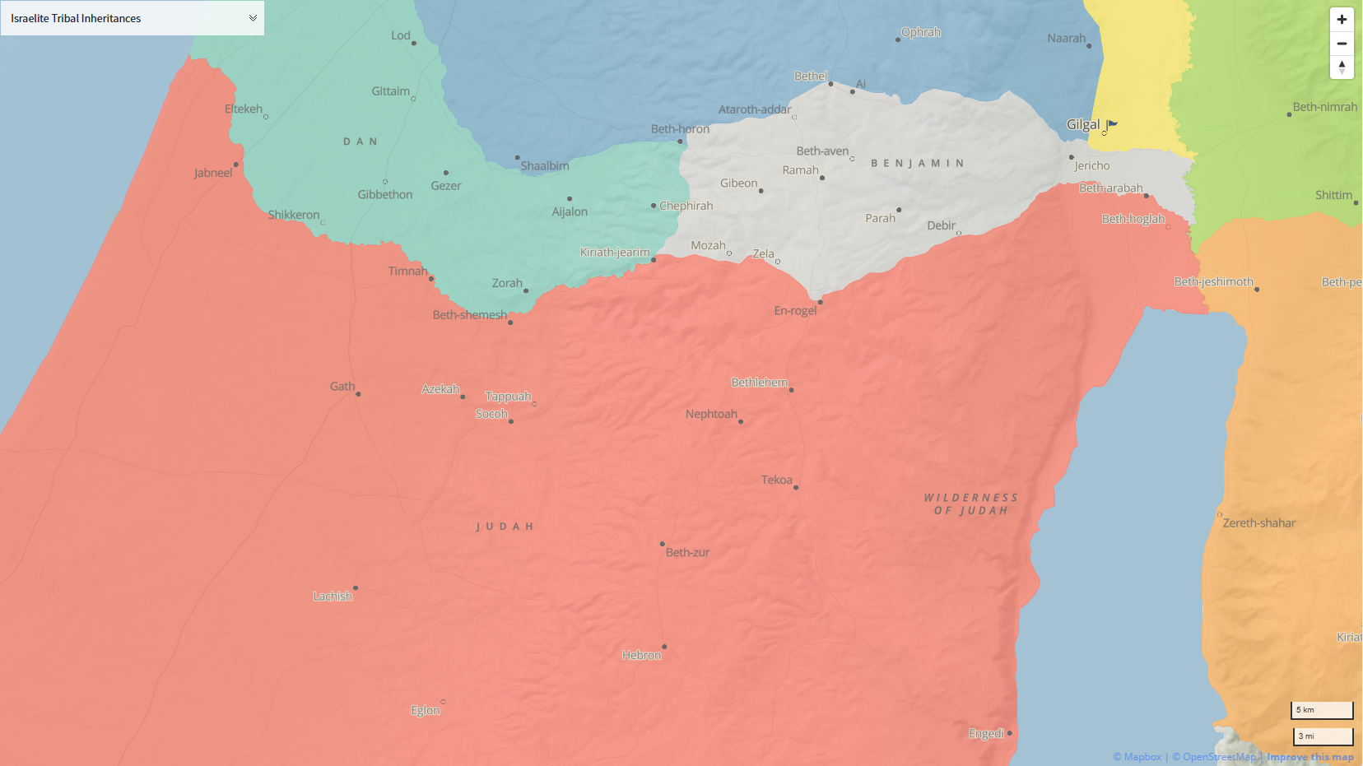
B
O
R
D
E
R
N
O
R
T
H
Mount Ephron

Slide 5
B
O
R
D
E
R
W
E
S
T
Mediterranean Sea
River of Egypt
Azmon
Akrabbim
Wilderness of Zin in the South

